Slide 1
Plotting the data & assessing correlations
Moses Ngari

Slide 2
Scatter diagrams
Read the "babies.csv“ dataset
Describe the data
What is N?
How many variables
Plot a scatter of gestwks ~ bweight.

Slide 3
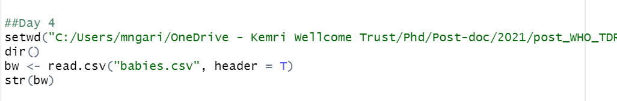
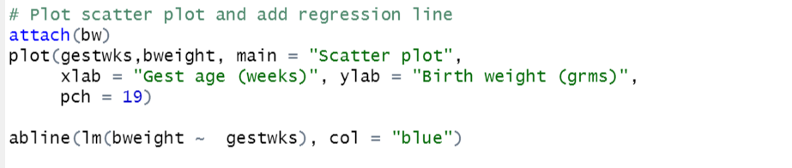

Slide 4
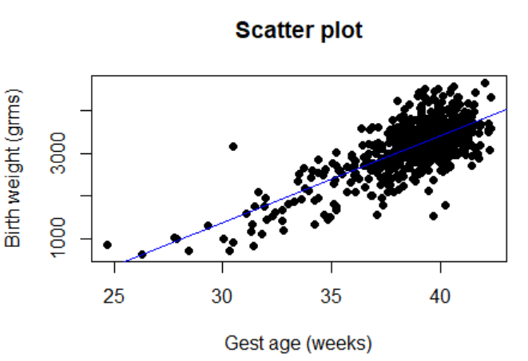

Slide 5
Scatter plot
Plot a scatter plot of matage vs. bweight

Slide 6
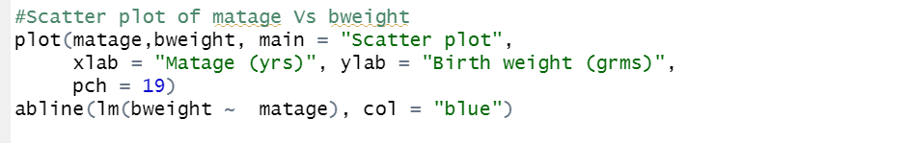
Scatter plot
Plot a scatter plot of matage vs. bweight

Slide 7
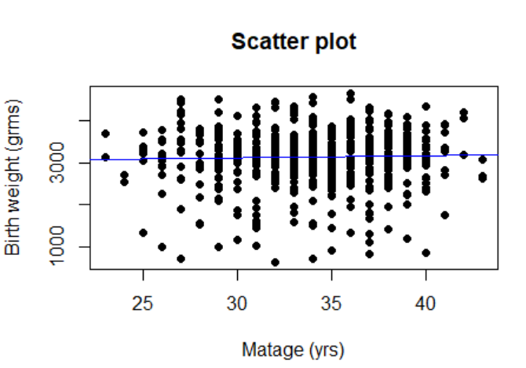

Slide 8
Correlation
Useful in the initial examination of a data set to identify relationships which deserve further study
Use a scatter plot to visualise a linear relationship
Can measure correlation between 2 continuous variables using the correlation coefficient
Appropriate for looking at correlation in bivariate normal data

Slide 9
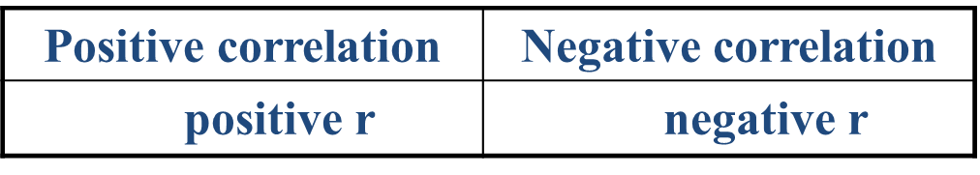
Properties of the Pearson correlation coefficient
It always lies between –1 and 1
No correlation
r = 0
variables are not linearly associated
the more the scatter of points about the line, the closer r will be to 0
r = –1 or + 1 if the points lie perfectly on the straight line

Slide 10
No correlation r = 0

Slide 11
No correlation r = 0

Slide 12
Positive Correlation
0 < r < 1
r = 1

Slide 13
Negative Correlation
-1 < r < 0
r = -1

Slide 14
Example in R
Using the "babies.csv“
What is the correlation between gestwks, bweight?

Slide 15

Example in R
Using the "babies.csv“
What is the correlation between gestwks, bweight?

Slide 16
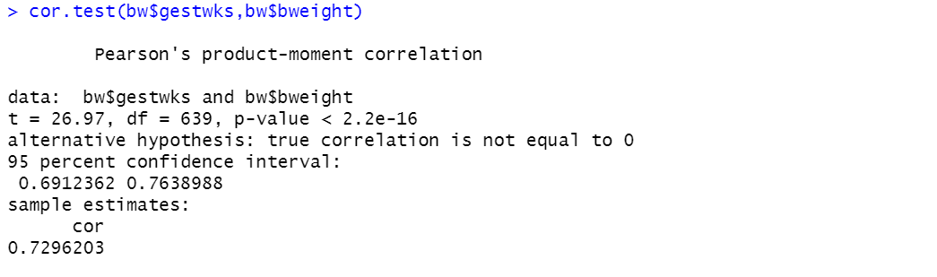

Slide 17
Practical: Correlations
Using the "babies.csv“
What is the correlation between matage, bweight?
Was the correlation significant?

Slide 18
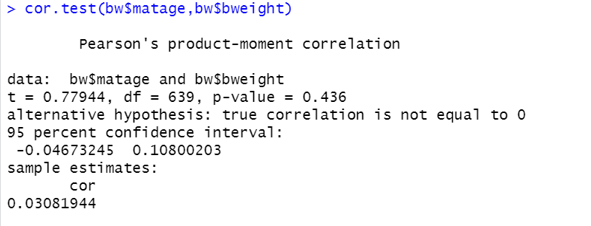

Slide 19
Summary
Assume when using r:
both variables have a normal distribution
observations are independent
r is quite sensitive to deviations from these assumptions
Can use Spearman rank correlation to measure and test correlation in non-normal data
not commonly used
only really use if data are heteroscedastic (different variability across scatter plot)
It is better to link two variables using regression and use this to measure association

